Slide 1

Year 7 Ratio & Map Scale
Dr J Frost (jfrost@tiffin.kingston.sch.uk)
www.drfrostmaths.com
Objectives: Understand what ratio means, simplify ratios, and solve problems involving values within a ratio.
Last modified: 18th May 2016

Slide 2
Stand up if…
You have two colours to pick from only.
Red
Blue
Stand up if you prefer (a) Red (b) Blue
Suppose the results were the following:
Suppose also we were unconcerned by exact numbers who voted for each but wanted to express the relative size of how many voted for each. What ways could we do this?
Red | 18
Blue | 12
Red 60%, Blue 40%
Percentages:
?
Percentages are good for indicating proportion of some total.
Ratio:
Ratio of red to blue:
3 : 2
?

Slide 3
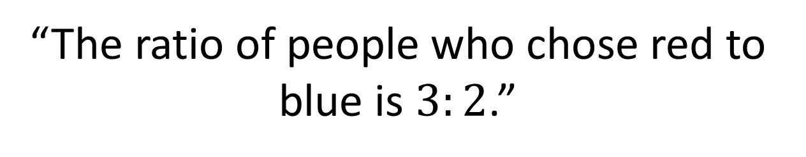
What is ratio?
“The ratio of people who chose red to blue is $3:2$.”
What specifically does this mean?
For each three people who chose red, two chose blue.
Quick Test of Understanding:
1
The ratio of monkeys to squirrels is 3:7. If there are 6 monkeys, how many squirrels are there?
If for each 3 monkeys there are 7 squirrels, then if there are twice as many monkeys, there are twice as many squirrels, i.e. 14.
Simplify the ratio 12:16. 3:4
?
2
?

Slide 4
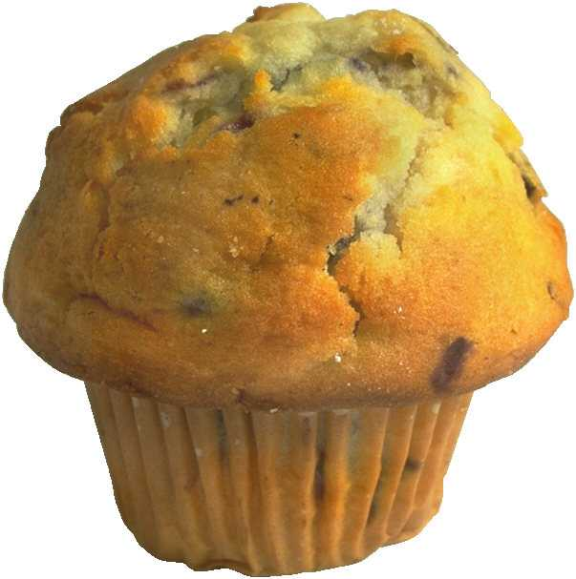
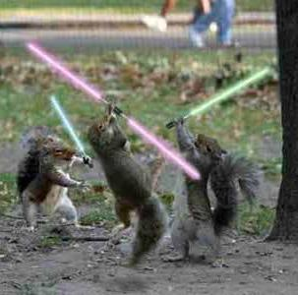
Common Types of Questions
The ratio of muffins to cupcakes in a cake sale is 3:1. There’s 20 cakes in total. How many muffins are there?
In a death match of monkeys vs squirrels, the monkeys outnumber the squirrels by a ratio of 5:2. There’s 35 monkeys. How many squirrels are there?
Bro Tip: Carefully reflect on what the number given (here the 20) represents in the ratio. Here the 20 represents the TOTAL parts.
?
Possible method: Identify what 1 ‘part’ is worth:
4 parts = 20
1 part = 5
3 parts = 15
Therefore 15 cupcakes.
?
?
5 parts = 35
1 part = 7
2 parts = 14
Therefore 14 squirrels.
?

Slide 5
Further Example
Alice and Bob share some money in the ratio 7:4.
Alice received £12 more than Bob.
What did they receive in total?
?
This time £12 represents the DIFFERENCE in the parts.
3 parts = £12
1 part = £4
11 parts = £44
We want the total amount, so need to find the value of the total parts.

Slide 6
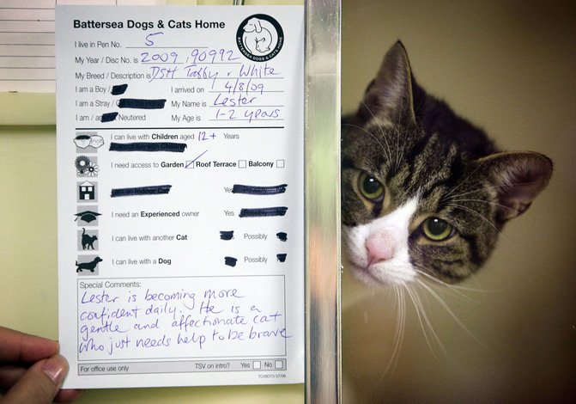

Test Your Understanding
1
The ratio of cats to dogs at Battersea Dogs & Cats home is 2:3. There are 45 animals in total. How many cats are there?
2
The ratio of Tiffin Boys students to Tiffin Girls students is 8:9. There’s 2700 students at Tiffin Girls. How many at Tiffin Boys?
?
2400
?
18
3
Tom, Dick and Harry share some money in the ratio 4:7:2.
Dick receives £35 more than Harry. How much did Tom and Dick receive in total?
?
£77

Slide 7

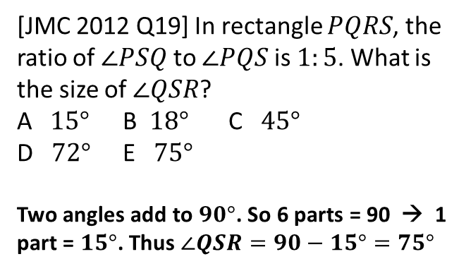
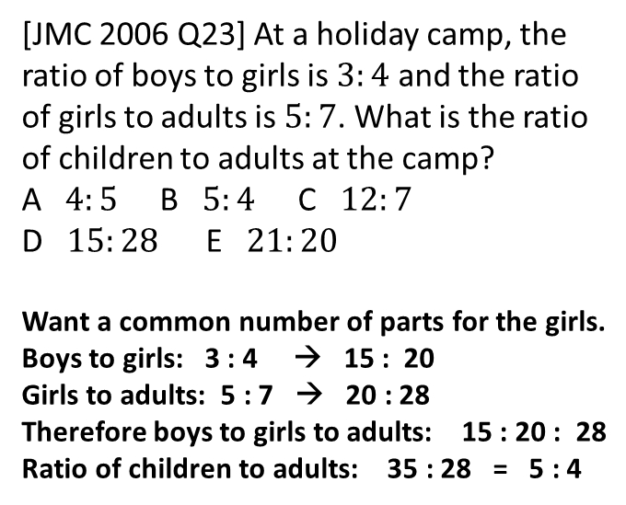
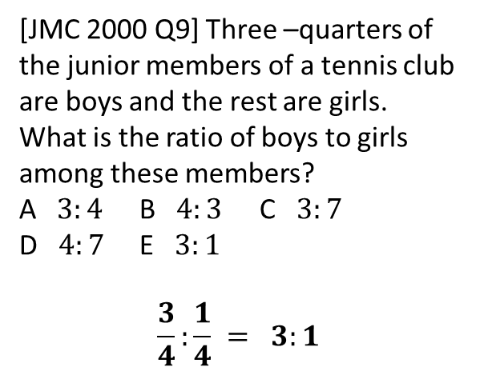
PUZZLES (working in pairs)
1
[JMC 2000 Q9] Three –quarters of the junior members of a tennis club are boys and the rest are girls. What is the ratio of boys to girls among these members? A $3:4$ B $4:3$ C $3:7$
D $4:7$ E $3:1$
$$\frac{3}{4}:\frac{1}{4} = 3:1$$
3
[JMC 2006 Q23] At a holiday camp, the ratio of boys to girls is $3:4$ and the ratio of girls to adults is $5:7$. What is the ratio of children to adults at the camp? A $4:5$ B $5:4$ C $12:7$
D $15:28$ E $21:20$
Want a common number of parts for the girls.
Boys to girls: 3 : 4 → 15 : 20
Girls to adults: 5 : 7 → 20 : 28
Therefore boys to girls to adults: 15 : 20 : 28
Ratio of children to adults: 35 : 28 = 5 : 4
?
?
2
[JMC 2012 Q19] In rectangle $PQRS$, the ratio of $∠PSQ$ to $∠PQS$ is $1:5$. What is the size of $∠QSR$? A $15°$ B $18°$ C $45°$ D $72°$ E $75°$ Two angles add to $90°$. So 6 parts = 90 → 1 part = $15°$. Thus $∠QSR=90−15°=75°$
?

Slide 8
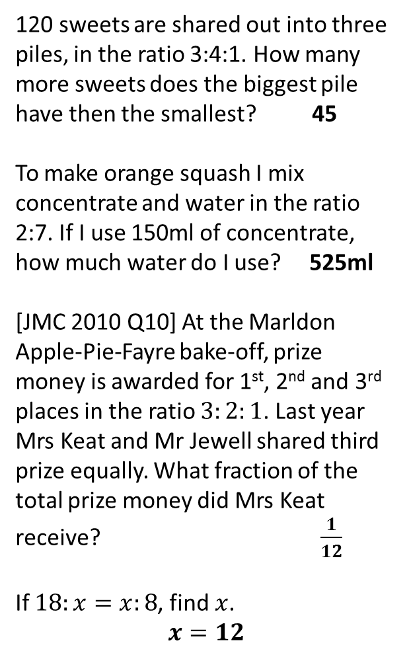
Exercise 1
(on provided worksheet)
1
Simplify the following ratios:
2:6 = 1:3 10:15 = 2:3
24:18 = 4:3 56 : 49 = 8:7
5
120 sweets are shared out into three piles, in the ratio 3:4:1. How many more sweets does the biggest pile have then the smallest? 45
To make orange squash I mix concentrate and water in the ratio 2:7. If I use 150ml of concentrate, how much water do I use? 525ml
[JMC 2010 Q10] At the Marldon Apple-Pie-Fayre bake-off, prize money is awarded for 1st, 2nd and 3rd places in the ratio $3:2:1$. Last year Mrs Keat and Mr Jewell shared third prize equally. What fraction of the total prize money did Mrs Keat receive? $\frac{1}{12}$
If $18:x=x:8$, find $x$.
$$x=12$$
?
?
?
?
?
2
What is the ratio of shaded to non-shaded triangles?
1 : 3
6
?
?
3
If £30 is split between two people in the ratio 3:2, what does each get? £18, £12
To make orange squash I mix concentrate and water in the ratio 2:7. If I use 150ml of concentrate, how much water do I use?
525ml
7
?
4
?
?
8
?

Slide 9
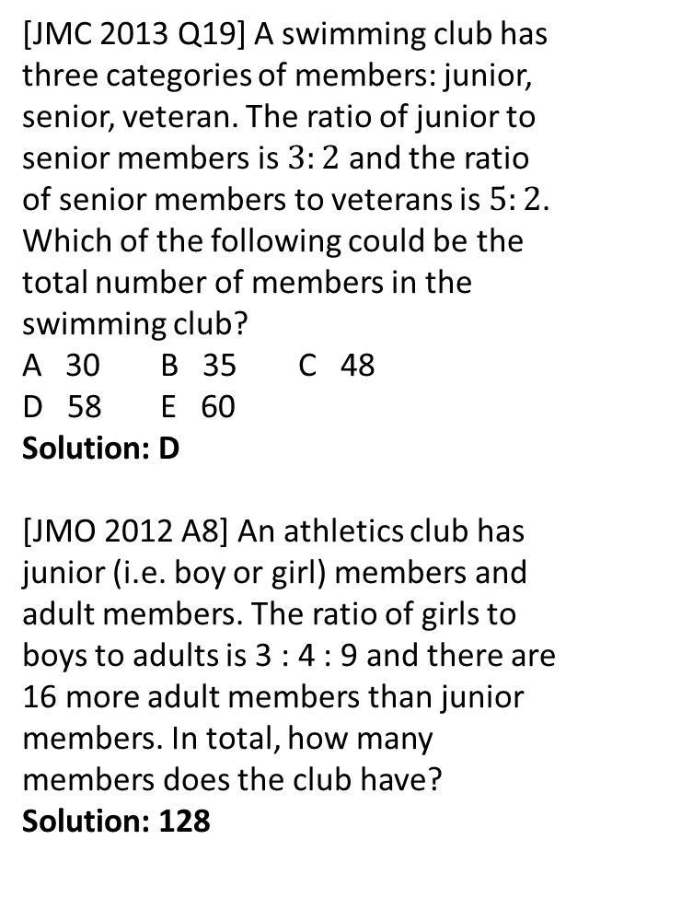
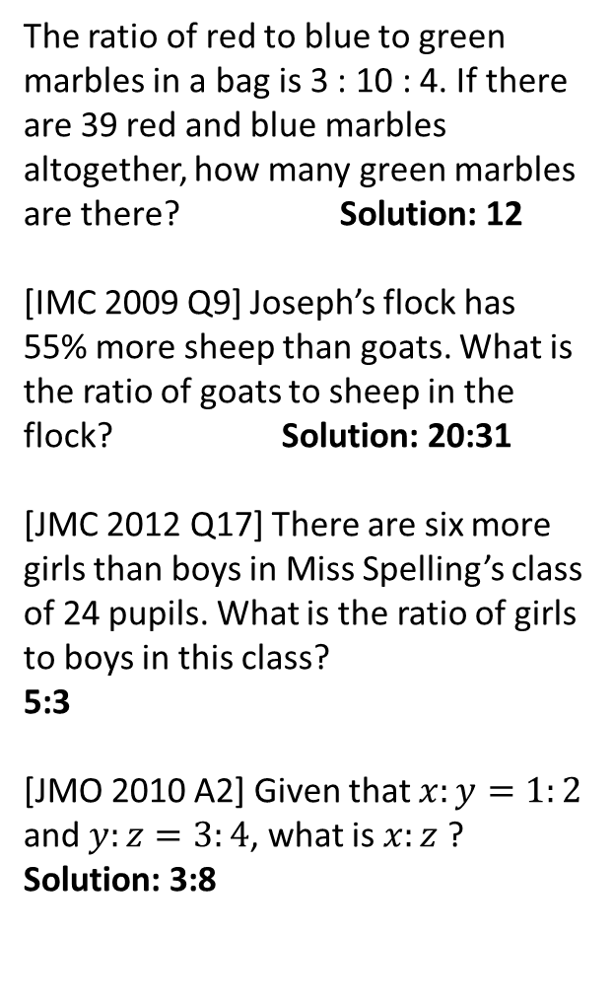
Exercise 1
(on provided worksheet)
9
The ratio of red to blue to green marbles in a bag is 3 : 10 : 4. If there are 39 red and blue marbles altogether, how many green marbles are there? Solution: 12
[IMC 2009 Q9] Joseph’s flock has 55% more sheep than goats. What is the ratio of goats to sheep in the flock? Solution: 20:31
[JMC 2012 Q17] There are six more girls than boys in Miss Spelling’s class of 24 pupils. What is the ratio of girls to boys in this class?
5:3
[JMO 2010 A2] Given that $x:y=1:2$ and $y:z=3:4$, what is $x:z$ ? Solution: 3:8
13
[JMC 2013 Q19] A swimming club has three categories of members: junior, senior, veteran. The ratio of junior to senior members is $3:2$ and the ratio of senior members to veterans is $5:2$. Which of the following could be the total number of members in the swimming club? A 30 B 35 C 48
D 58 E 60 Solution: D
[JMO 2012 A8] An athletics club has junior (i.e. boy or girl) members and adult members. The ratio of girls to boys to adults is 3 : 4 : 9 and there are 16 more adult members than junior members. In total, how many members does the club have? Solution: 128
?
10
?
?
11
14
?
12
?
?

Slide 10
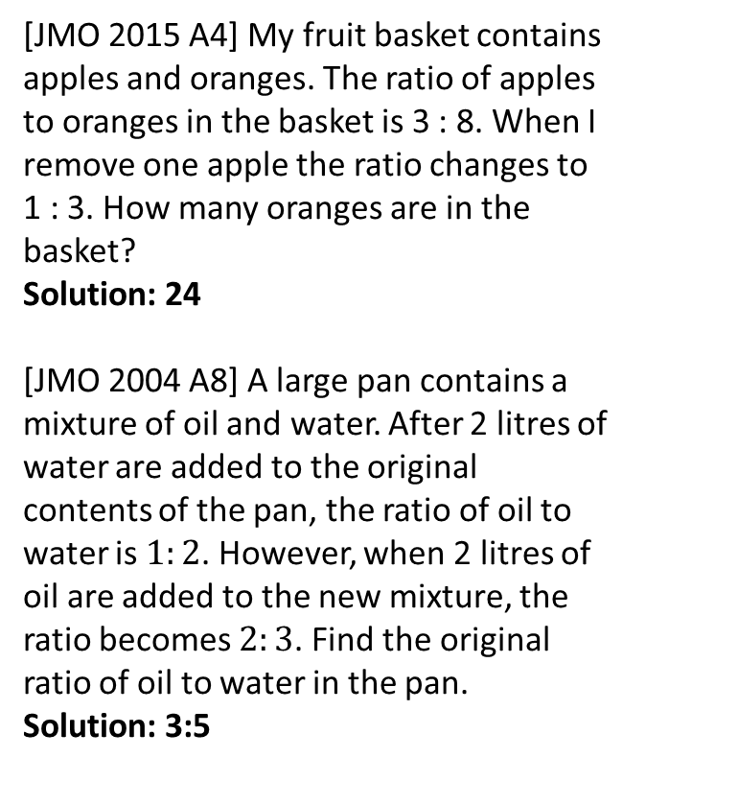
Exercise 1
(on provided worksheet)
15
[JMO 2015 A4] My fruit basket contains apples and oranges. The ratio of apples to oranges in the basket is 3 : 8. When I remove one apple the ratio changes to 1 : 3. How many oranges are in the basket? Solution: 24
[JMO 2004 A8] A large pan contains a mixture of oil and water. After 2 litres of water are added to the original contents of the pan, the ratio of oil to water is $1:2$. However, when 2 litres of oil are added to the new mixture, the ratio becomes $2:3$. Find the original ratio of oil to water in the pan. Solution: 3:5
N
[STMC Final 2007/08 Q1] Anne, Becky and Charlotte had sums of money in the ratio 7:6:5. One of them gave £9 to one of the others and this changed the ratio (in the same order of names) to 6:5:4. The total sum of money remained the same; what was it? Solution: £810
?
16
?
?

Slide 11
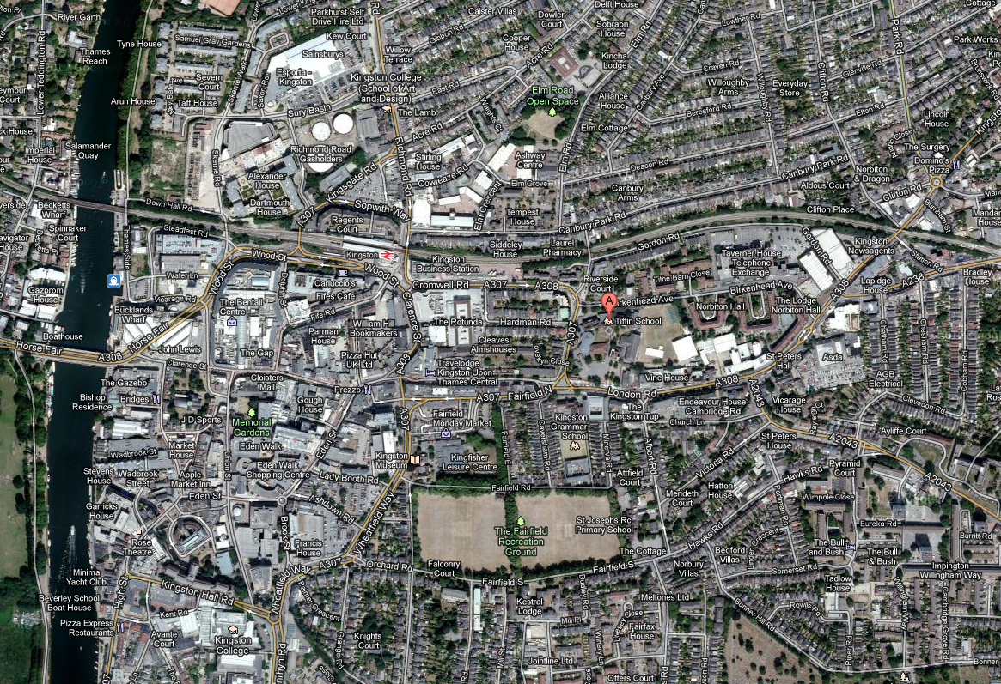
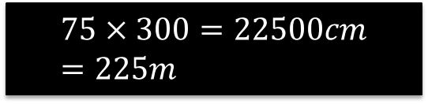
You have a map of Kingston-upon-Thames…
Scale 1:300
← What does this scale mean?
?
It means that 1cm on the map represents 300cm in real life.
(Note the units had to be consistent)
75cm
Tiffin
John Lewis
What distance is this in real life?
?
$$75×300=22500cm \\ =225m$$

Slide 12

Examples
1
If a map scale is 1:100 000, and two locations are 6.2 cm apart on the map, what distance in km does this represent?
$$6.2×10 0000=620 000 cm \\ =6200 m=6.2 km$$
If a map scale is 1: 5000, and two locations are 3.2km apart, how far are they away on the map in cm?
$$3.2 km=3200 m=320 000 cm \\ 320 000÷5 000=64 cm$$
Bobville and Daveton are 4cm apart on a map, but 1km apart in real life. Determine the scale of the map.
$$4cm :1km=4cm :1000m=4cm :100 000cm \\ =1 :25 000$$
?
Bro Tip: When scaling a length you’re still in the same unit!
2
?
3
?

Slide 13
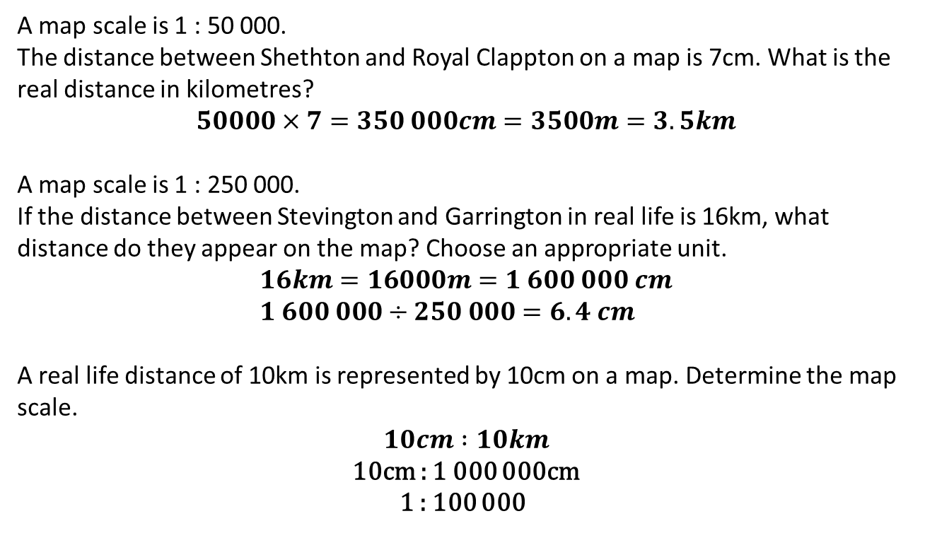
Test Your Understanding
A map scale is 1 : 50 000.
The distance between Shethton and Royal Clappton on a map is 7cm. What is the real distance in kilometres?
$$50000×7=350 000cm=3500m=3.5km$$
A map scale is 1 : 250 000.
If the distance between Stevington and Garrington in real life is 16km, what distance do they appear on the map? Choose an appropriate unit.
$$16km=16000m=1 600 000 cm \\ 1 600 000÷250 000=6.4 cm$$
A real life distance of 10km is represented by 10cm on a map. Determine the map scale.
$$10cm :10km$$ 10cm : 1 000 000cm 1 : 100 000
1
?
2
?
3
?

Slide 14
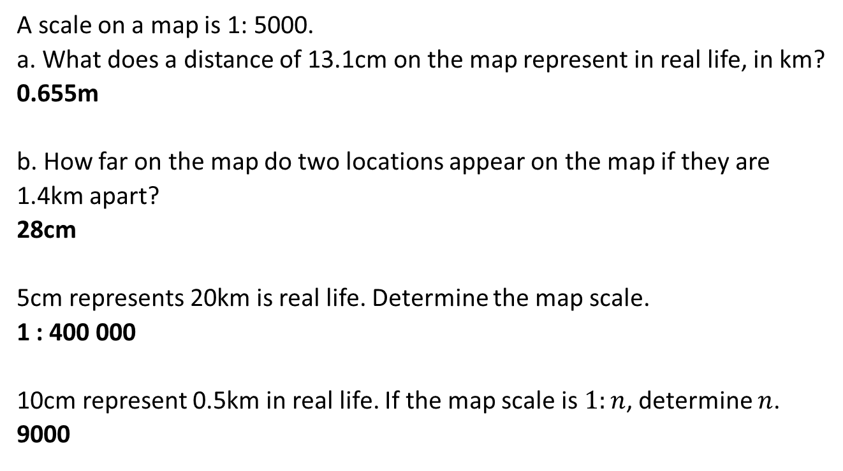
Further Practice
1
A scale on a map is 1: 5000.
a. What does a distance of 13.1cm on the map represent in real life, in km? 0.655m b. How far on the map do two locations appear on the map if they are 1.4km apart? 28cm
5cm represents 20km is real life. Determine the map scale. 1 : 400 000
10cm represent 0.5km in real life. If the map scale is $1:n$, determine $n$. 9000
?
?
2
?
3
?

